Slide 1

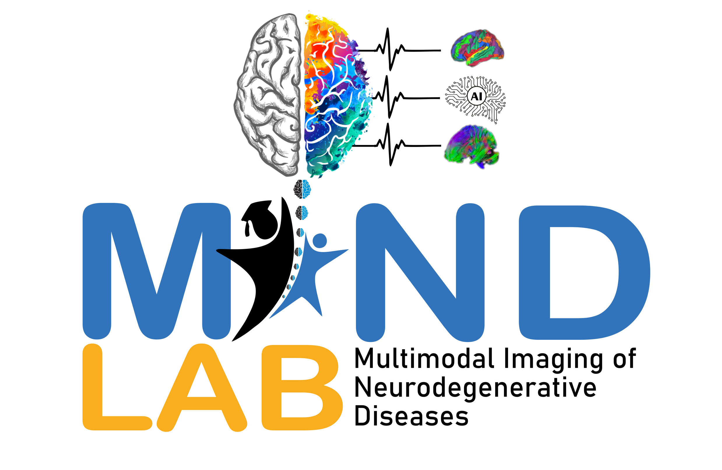



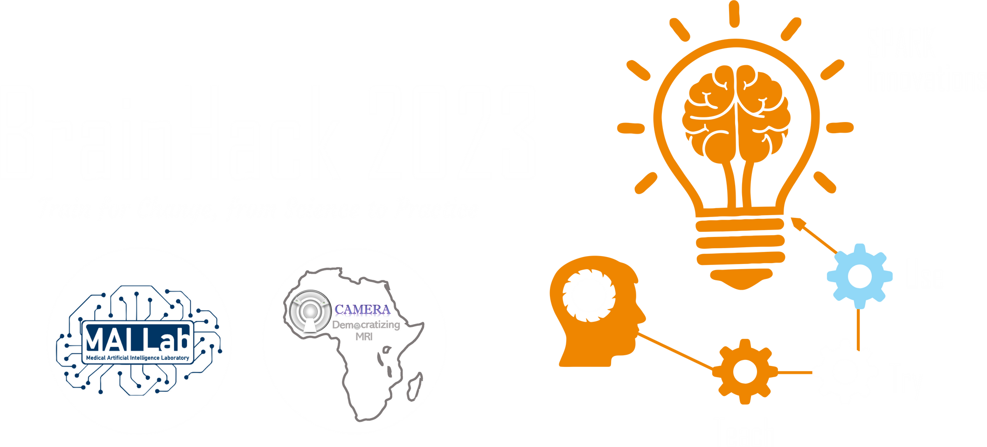
2025 SPARK ACADEMY
TRAIN FOR CHANGE, FROM SCIENCE TO PRACTICE
THE SPRINT AI TRAINING FOR AFRICAN MEDICAL
Imaging Knowledge Translation (SPARK)
Academy
IN DEEP LEARNING & MEDICAL IMAGING
Virtual Foundational Course Tutorial
Advanced Deep Learning Techniques I
Fine‑Tuning Pre‑trained Models Medical Imaging
April 19th, 2025

Slide 2
Outline
Transfer Learning
Coding Session - Tumor Detector Using Transfer Learning
https://event.fourwaves.com/spark

Slide 3
“What is transfer learning?”
Transfer learning is a paradigm in which a model pre‑trained on one task is repurposed to initialize learning on a related task.
Surely someone has spent the time crafting the right model for the job… with transfer learning you can reuse that pre‑trained model as a starting point for your own similar task, dramatically cutting down on training time and computational cost.
3

Slide 4
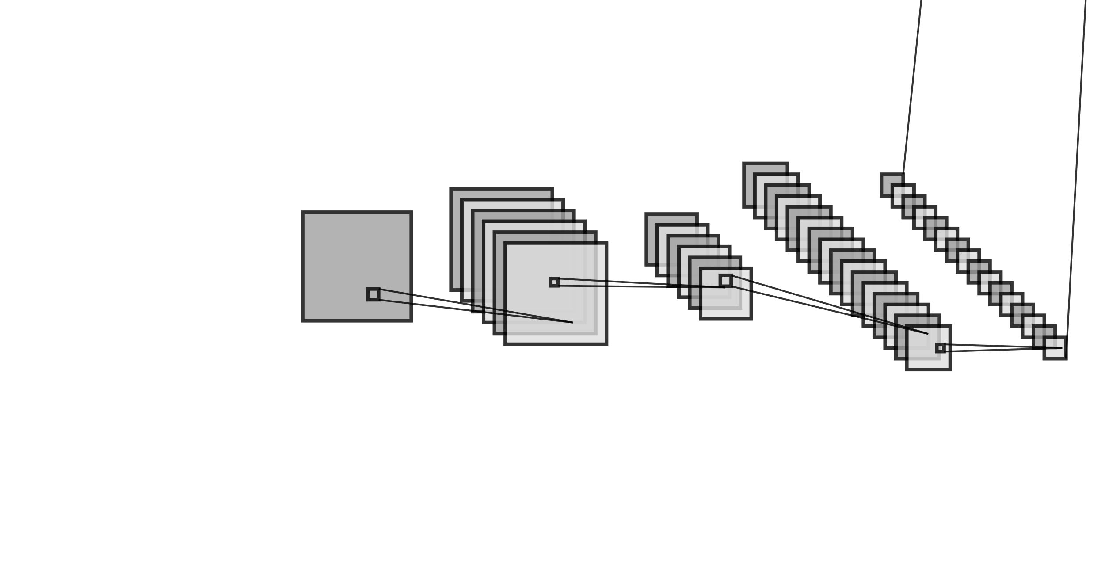
CNN Review
CNN Feature Hierarchy and Classification
Initial convolutional layers apply filters over local receptive fields to detect simple patterns (e.g. edges, lines).
Deeper convolutional layers integrate these basic features into increasingly complex representations.
Pooling layers downsample feature maps, reducing spatial dimensions while retaining salient information.
Final fully connected layers use the resulting feature hierarchy to perform task‑specific classification (e.g. Healthy, Viral Pneumonia, COVID‑19, Bacterial Pneumonia).
F. Maps
16@ 6x6
576x1
F. Maps
16@ 12x12
170x1
Feature Maps
6@ 28x28
120x1
Input
28x28
F. Maps
6@ 14x14
Output
10x1
Conv 1
3x3 Kernel
Stride = 1
Padding = 1
Conv 2
3x3 Kernel
Stride = 1
Padding = 0
Downsample 1
Max Pool 1
2x2 Size
Stride = 2
Full Connection
Downsample 2
Max Pool 2
2x2 Size
Stride = 2
Flatten
Full Connection
Full Connection
4

Slide 5
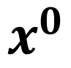
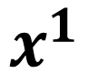
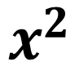
Review – Artificial Neural Networks (ANNs)
Standard “fully connected” artificial neural networks were the focus of Section I - IV
These networks received an input (a single vector) and transformed it through a series of hidden layers
Hidden layers are composed of neurons, with each neuron connected to all neurons in the layers before and after it
Within a single layer, neurons are completely independent
The end result is an output layer
$$x^{0}$$
$$x^{1}$$
$$x^{2}$$
5

Slide 6



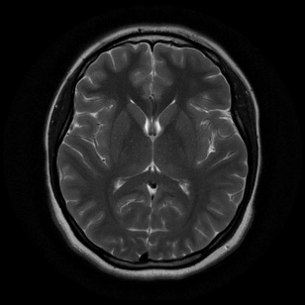
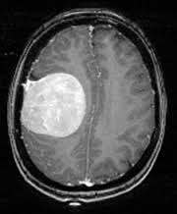
Example transfer learning use cases
Computer vision
NO
YES
Model learns patterns/weights from similar problem space
Patterns get used/tuned to specific problem

Slide 7
Improving a model
Method to improve a model (reduce overfitting)
What does it do?
Gives a model more of a chance to learn patterns between samples (e.g. if a model is performing poorly on images of tumor, show it more images of tumor).
More data
Increase the diversity of your training dataset without collecting more data (e.g. take your images of tumor cases and randomly rotate them 30°).
Increased diversity forces a model to learn more generalisation patterns.
Data augmentation
Not all data samples are created equally. Removing poor samples from or adding better samples to your dataset can improve your model’s performance.
Better data
Take an existing model’s pre-learned patterns from one problem and tweak them to suit your own problem. For example, take a model trained on pictures of cars to recognise pictures of trucks.
Use transfer learning

Slide 8


Why use transfer learning?
Can leverage an existing neural network architecture proven to work on problems similar to our own
Can leverage a working network architecture which has already learned patterns on similar data to our own (often results in great results with less data)
NO
YES
Learn patterns in a wide variety of images (using ImageNet)
Pretrained EfficientNet architecture (already works really well on computer vision tasks)
Extract/tune patterns/weights to suit our own problem (Tumor Dataset)
Model performs better than from scratch

Slide 9

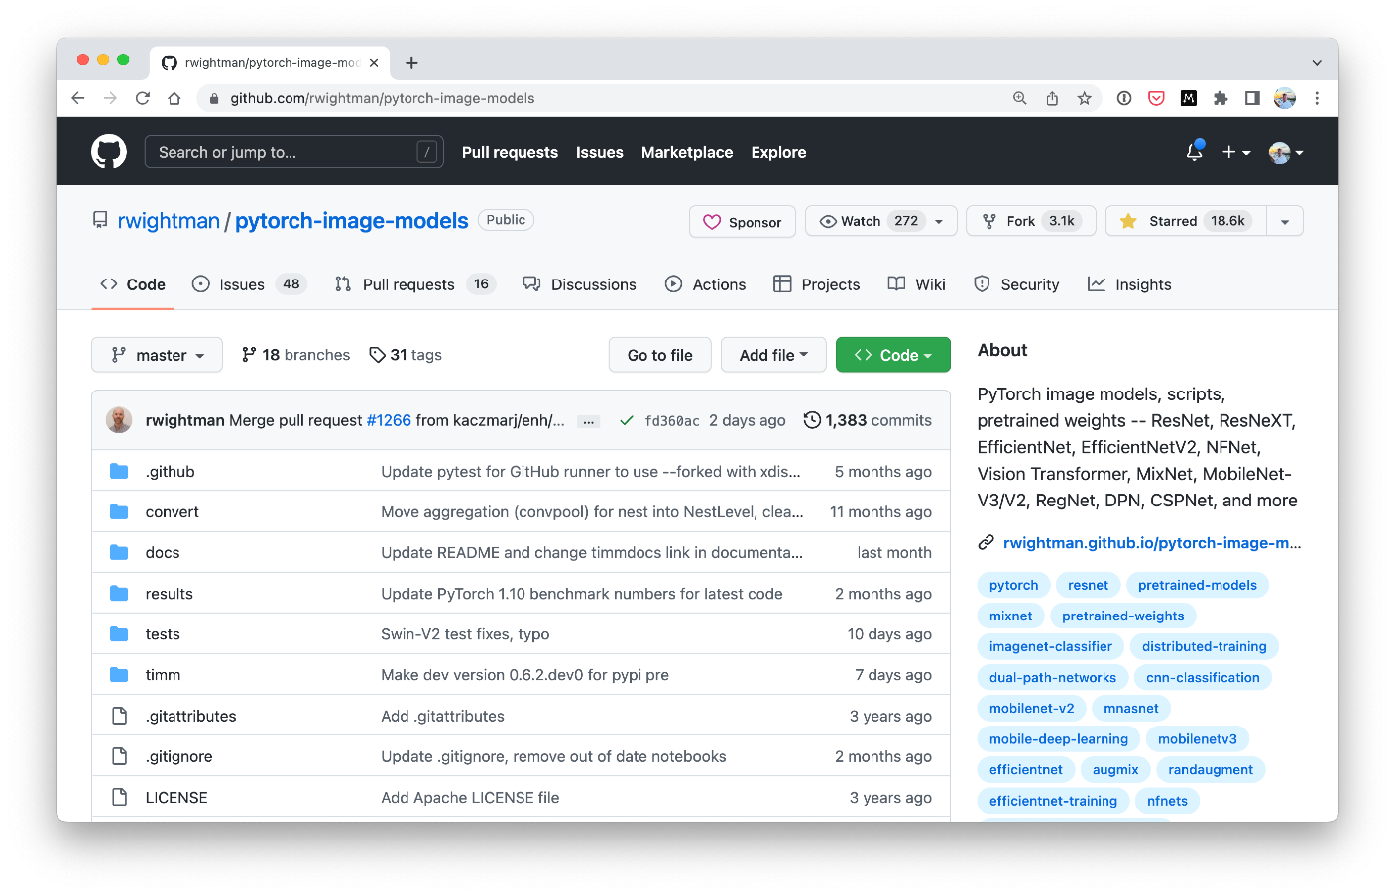
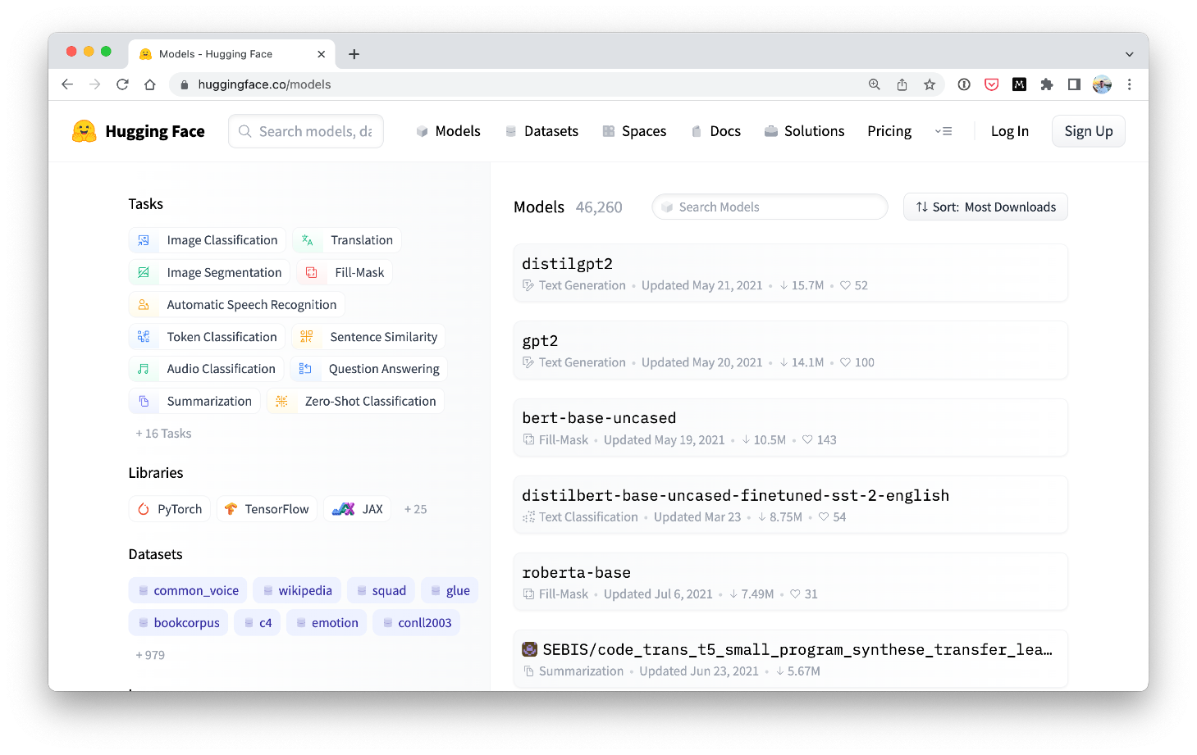


Where to find pretrained models
PyTorch domains libraries (torchvision, torchtext, torchaudio, torchrec). Source: https://pytorch.org/vision/stable/models.html
Torch Image Models (timm library).
Source: https://github.com/rwightman/pytorch-image-models
HuggingFace Hub.
Source: https://huggingface.co/models
Paperswithcode SOTA.
Source: https://paperswithcode.com/sota

Slide 10
Original Model vs. Feature Extraction
ImageNet has 1000 classes
Changes
Output layer(s) gets trained
Output Layer (shape = 1000)
3
on new data
…
…
Layer 235
Layer 235
Layer 234
Layer 234
Working architecture
(e.g. EfficientNet)
Stays same (frozen)
…
(original model layers don’t update during training)
…
Layer 2
Layer 2
Input Layer
Input Layer
…
…
Changes
Large dataset (e.g. ImageNet)
Original Model
Different dataset (e.g. 3 classes of Tumor)
Feature Extraction Transfer Learning Model

Slide 11
Kinds of Transfer Learning
Top layers get trained
on new data
Output Layer (shape = 1000)
Changes
3
Stays same
3
…
…
…
Layer 235
Layer 235
Layer 235
Changes (unfrozen)
Layer 234
Layer 234
Layer 234
Stays same (frozen)
…
…
…
Layer 2
Layer 2
Layer 2
Stays same (frozen)
Input Layer
Input Layer
Input Layer
…
…
…
Changes
Might change
Fine-tuning
usually requires
more data than
Large dataset (e.g. ImageNet)
Original Model
Different dataset (e.g. 3 classes of Tumor)
Feature Extraction
feature
extraction
Fine-tuning

Slide 12
Kinds of Transfer Learning
Type
Description
What happens
When to use
Take a pretrained model as it is and apply it to your task without any changes.
The original model remains unchanged.
Helpful if you have the exact same kind of data
the original model was trained on.
Original model (“As is”)
Take the underlying patterns (also called weights) a pretrained model has learned and adjust its outputs to be more suited to your problem.
Most of the layers in the original
Helpful if you have a small amount of custom
Feature extraction
model remain frozen during training tr data (similar to what the original model was
(only the top 1-3 layers get updated).
ained on) and want to utilise a pretrained model
to get better results on your specific problem.
Take the weights of a pretrained model and adjust (fine-tune) them to your own problem.
Some, many or all of the layers in the pretrained model are updated during training.
Helpful if you have a large amount of custom data and want to utilise a pretrained model and improve its underlying patterns to your specific problem.
Fine-tuning

Slide 13
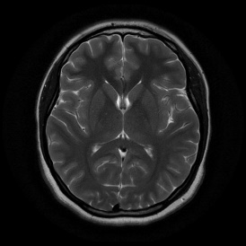
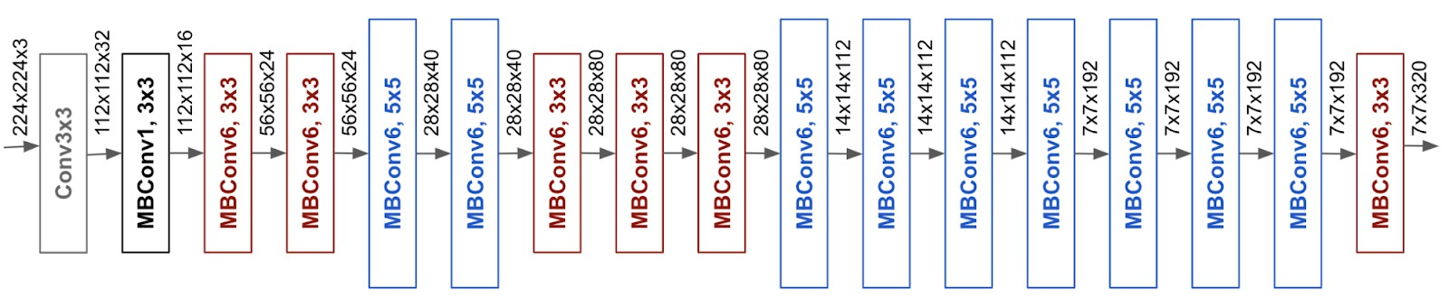
EfficientNet feature extractor
Changes
(same shape as number of classes)
Input data (YES, NO)
Stays same
(frozen, pretrained on ImageNet)
NO
2
YES
EfficientNetB0 architecture. Source: https://ai.googleblog.com/2019/05/efficientnet-improving-accuracy-and.html
EfficientNetB0 Backbone (torchvision.models.efficientnet_b0)
Linear classifier layer
(torch.nn.Linear)

Slide 14
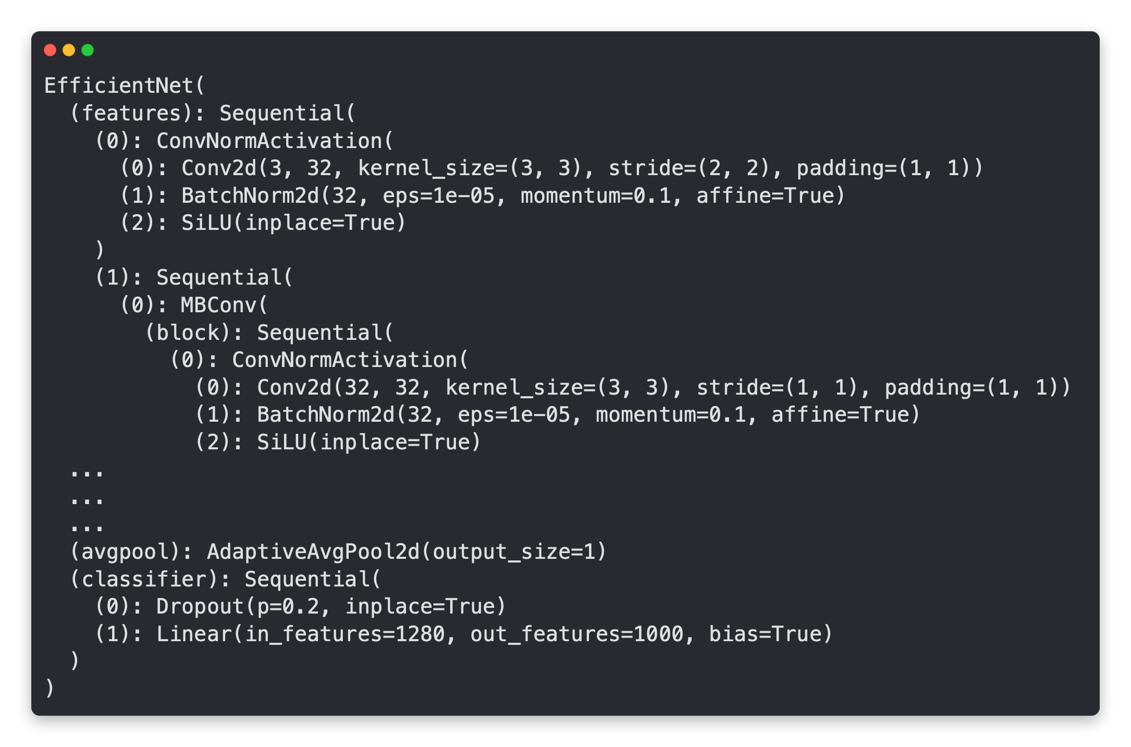
EfficientNet feature extractor
EfficientNetB0 Backbone
(torchvision.models.efficientnet_b0(prertained=True)
Extracts features
from image
Turns features into a feature vector (by taking the average)
Turns feature vector into prediction logits
Can adjust depending on the number of classes you have

Slide 15

EfficientNet feature extractor — changing the classifier head
EfficientNetB0 Backbone
(torchvision.models.efficientnet_b0(prertained=True)
Same
Changed
Original Model
Original Model + Changed Classifier Head
(3 output classes for)
(1000 output classes for ImageNet)

Slide 16
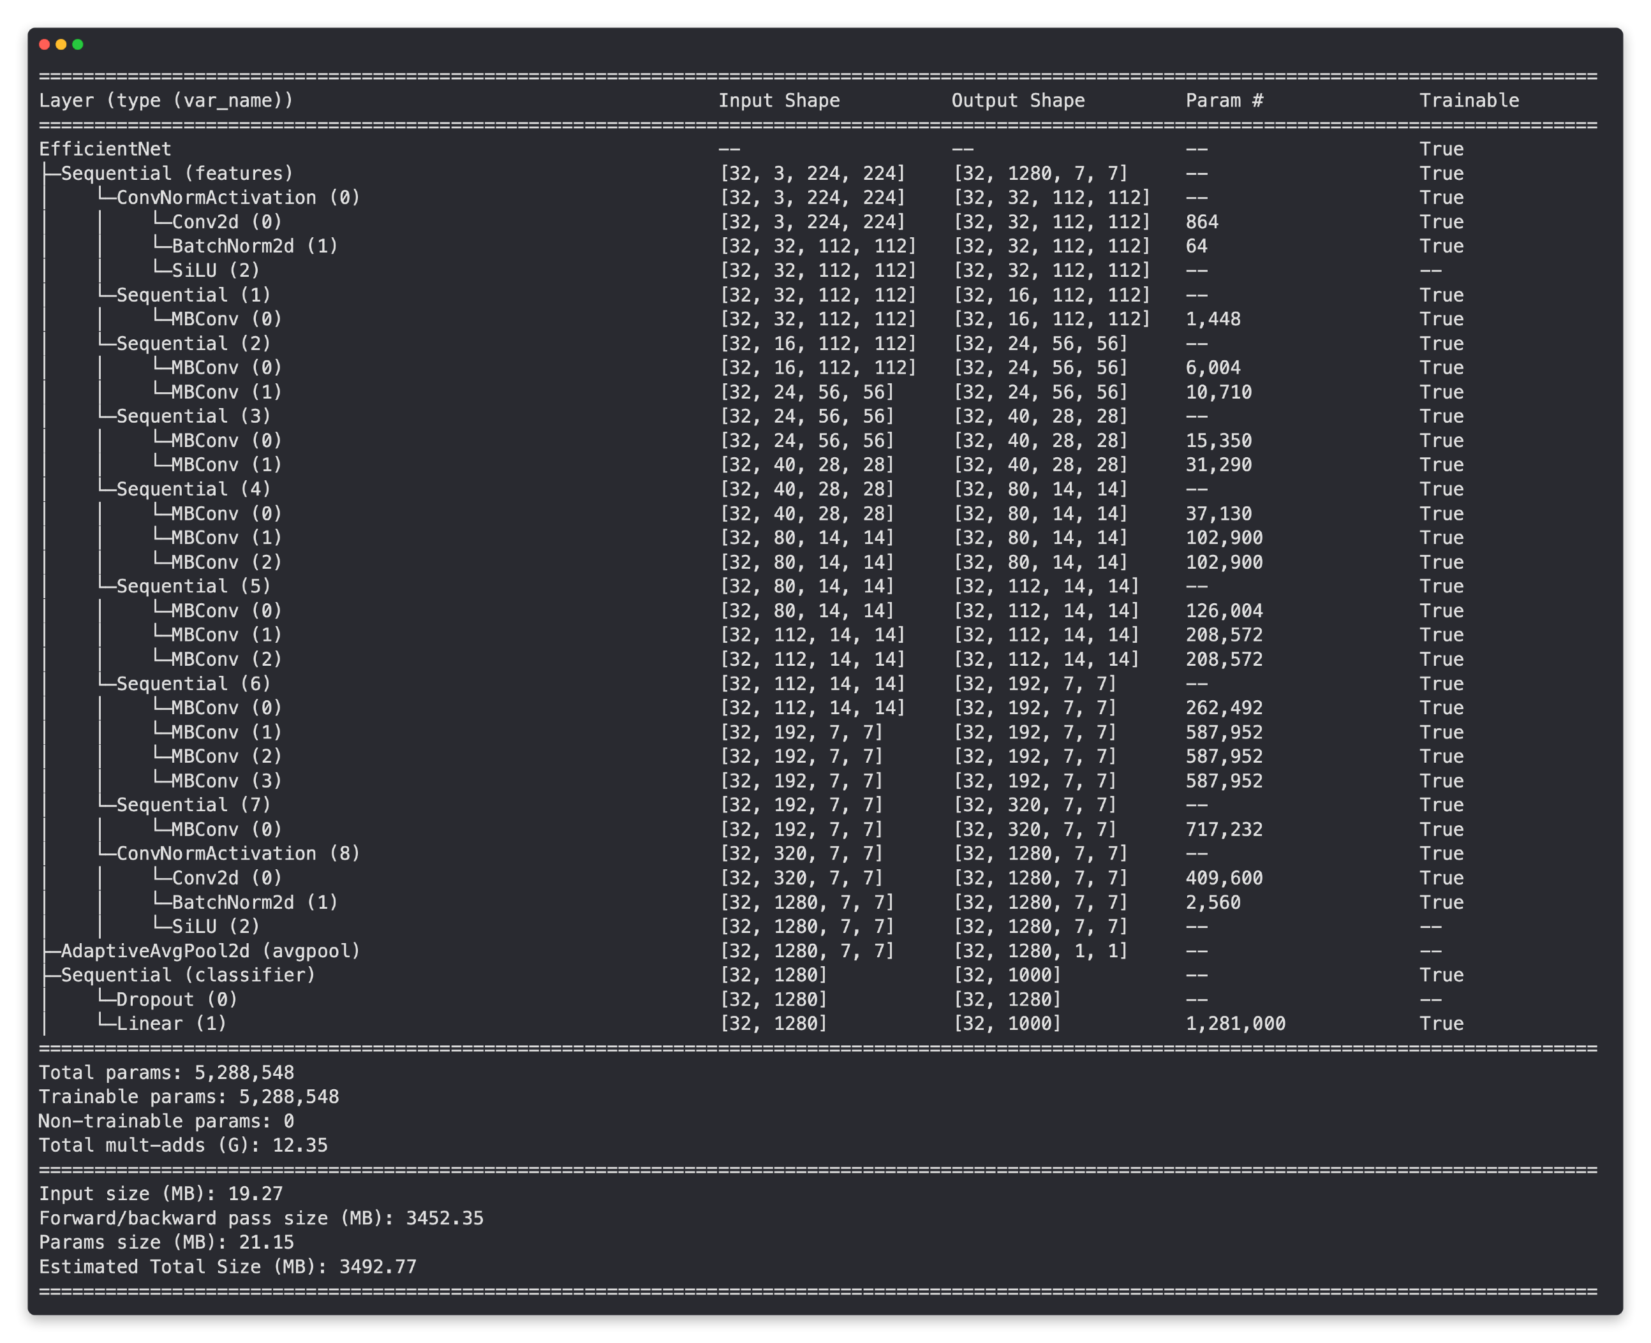
Input shape of data per layer Output shape of data per layer
torchinfo.summary(model, input_size=(32, 3, 224, 224))
Are the layers trainable? (unfrozen)
Total number of parameters and trainable parameters

Slide 17
torchinfo.summary(model, input_size=(32, 3, 224, 224))
Many layers
untrainable (frozen)
Only last layers are trainable
Final layer output (same as number of classes )
Less trainable parameters because many layers are frozen

